Slide 1


Major Project Presentation
Based on Web development by using MERN and Mongo DB

Slide 2
Project worked on by:
Sl. No. | Name | Roll Number | Registration Number
1 | Akshay Chatterjee | 32201220091 | 203221001210003
2 | Saikat Mondal | 32201220051 | 203221001210043
3 | Sarbajit Banerjee | 32201220052 | 203221001210042
4 | Avijeet Gorai | 32201220060 | 203221001210034
5 | Sumit Mahato | 32201220083 | 203221001210011
Achieved by Using MERN Stack (REACT APP) and Mongo DB (Database)

Slide 3
Acknowledgement :
It is our great privilege to express profound and sincere gratitude to our Project Supervisor, Sujoy Kumar Basu, Asistant Professor for providing us with very cooperative and precious guidance at every stage of the present project work being carried out under his supervision. His valuable advice and instructions in carrying out the present study has been a very rewarding and pleasurable experience that has greatly benefited us throughout the course of work.
We would like to convey our sincere gratitude towards DR. PINTU PAL, Head of the Department of Computer Application, Asansol Engineering College for providing us the requisite support for time completion of our work. We would also like to pay our heartiest thanks and gratitude to all the teachers of the Department of Computer Application, Asansol Engineering College for various suggestions being provided in attaining success in our work.
We would like to express our earnest thanks to our other colleagues along with all technical staff of the Department of Computer Application, Asansol Engineering College for their valuable assistance being provided during our project work.
Finally, we would like to express our deep sense of gratitude to our parents for their constant motivation and support throughout our work.

Slide 4
INTRODUCTION
Nowadays many systems have been developed to make life easier. The system will include database that will record all the data. For the private hospital, usually they are using digital system to record the patient information and other information that related to the hospital. There are many systems for clinic management system, but it does not meet the local user requirement that is still new in the electronic system. Here, it will be more explanation of the system.
Revo Clinic is developed to improve the clinic management and automates the workflow that happens in the clinic. This system is considering all the activities in the clinic. Patient will make registration first. If the patient never registered before, patient information collected and stored in the database. However, if it is an existing patient the patient data is search-using IC (identification card) no. This will improve the record of the patient and save the time during the registration. At this time, patient is assign to the doctor Once the patient gets the treatment, the doctor will send the report including the medicine name. The staff will view the report and complete the patient record. After that, the staff will prepare the bills for the patient. The patient can choose mode to pay cash or maybe the clinic is panel doctor for the patient. Then the staff will update the medicine stock and the patient record will be kept in database. 2 The clinic management system is very beneficial for a clinic/doctor. It will stores complete patient record. The most important thing is it will make it easier for the retrieval of history information of the patient. In case, if patient is allergic for certain medicine, the doctor may detect what type of medicine. For the security, before the user enters the system they have to input their username and password before log in to the system. The system has different access for the difference user. For the management of the clinic, they may view the daily report of clinic.

Slide 5
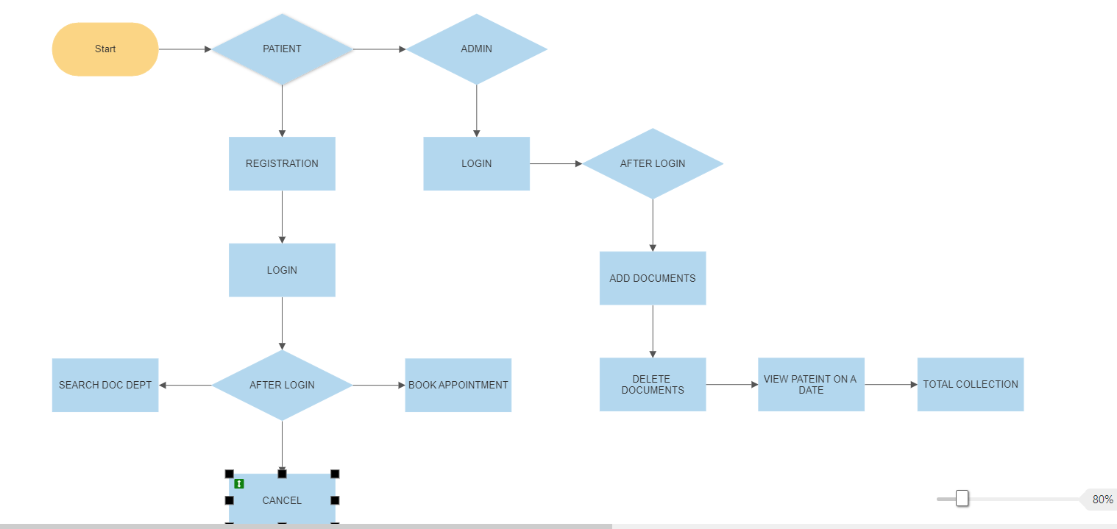
PROJECT WORKFLOW:-
REVO CLINIC

Slide 6
SOFTWARE AND HARDWARE REQUIREMENTS
Hardware:-
PROCESSOR :- Intel i3 or i5 1.8GHz
MOTHERBOARD :- According to the processor requirement
RAM :- 8GB
FREE DISK SPACE :- 300MB
Software:-
Ui Development – React 18.x, ES 6, HTML 5, CSS.
Frontend To Backend Communication – REST API
Backend – NodeJS
Server – Express JS
Database – MongoDB
Node JS – MongoDB connection using Mongoose
IDE USED – VS Code

Slide 7
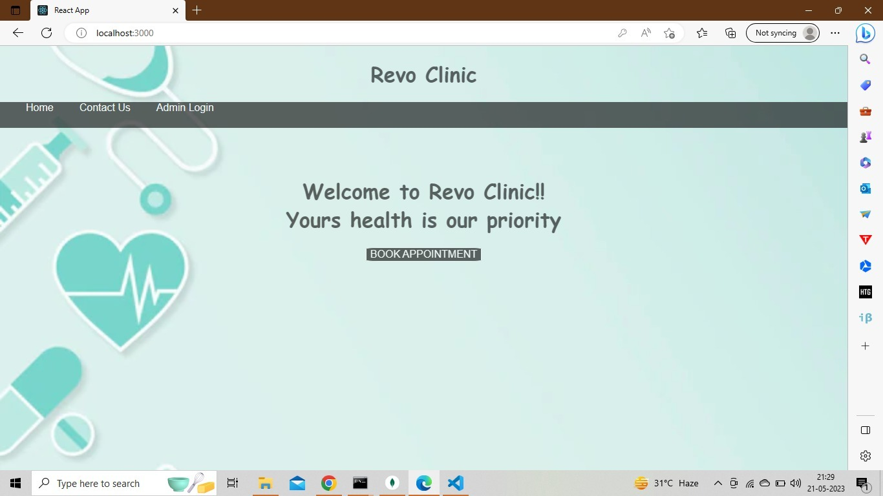
HOME PAGE OF THE CLINIC
PROJECT SCREENSHOT

Slide 8
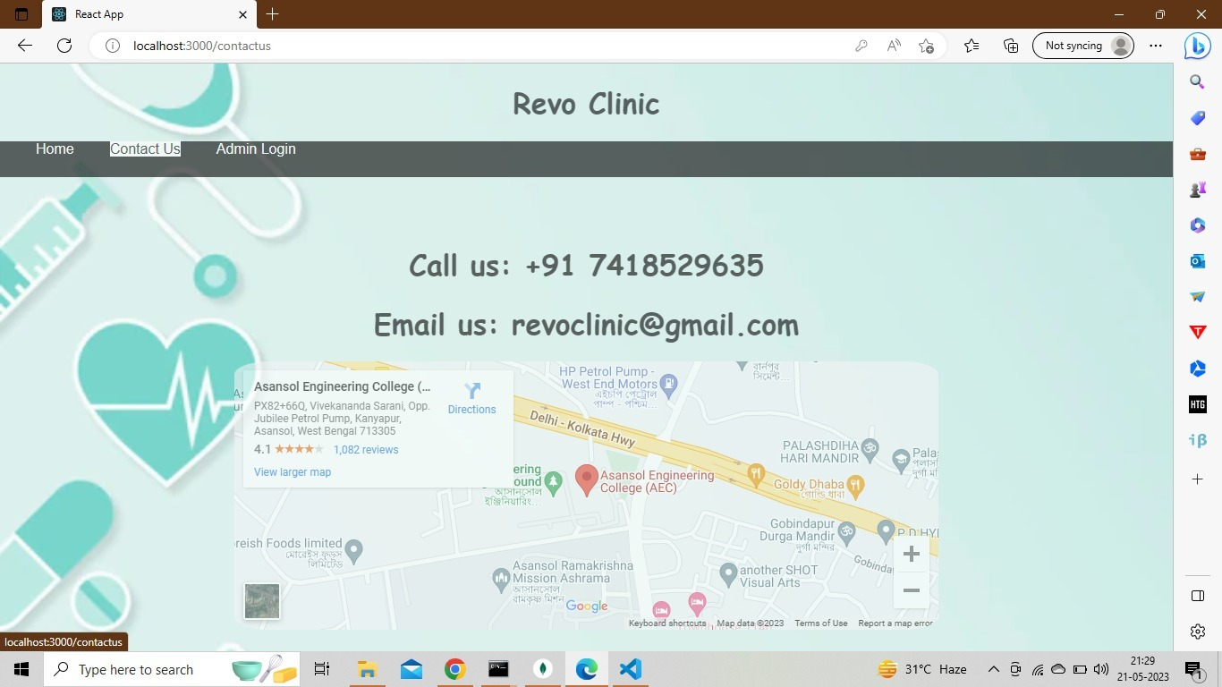
CONTACT US PAGE OF THE CLINIC

Slide 9
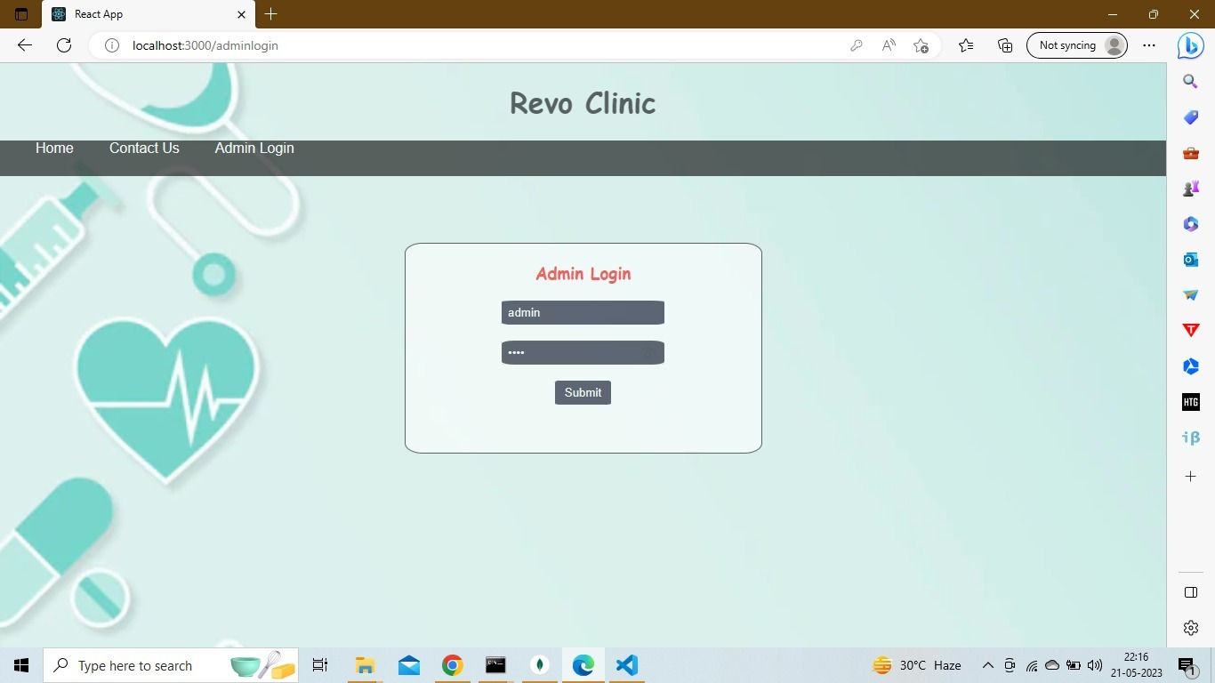
ADMIN LOGIN PAGE FOR LOGING IN TO THE ADMIN PAGE

Slide 10
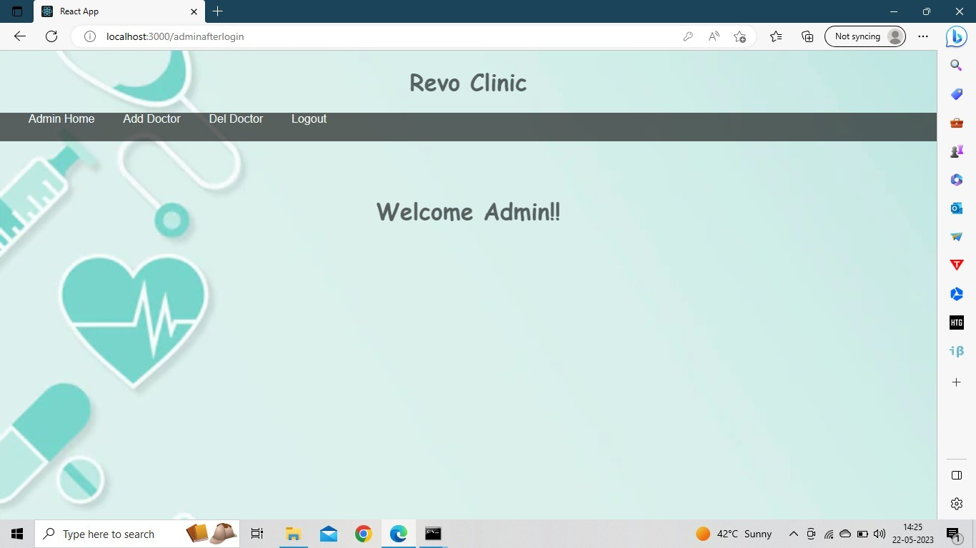
ADMIN AFTER LOGIN HOME PAGE

Slide 11
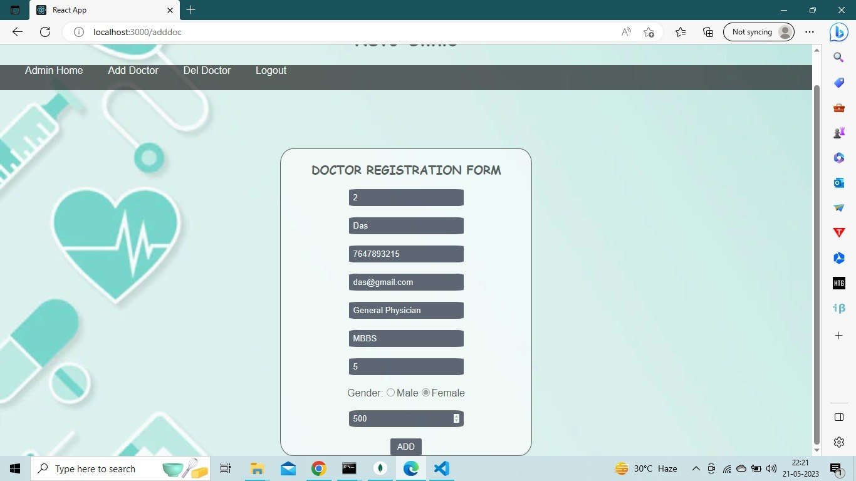
DOCTOR REGISTRATION PAGE FOR ADMIN TO ADD DOCTORS

Slide 12
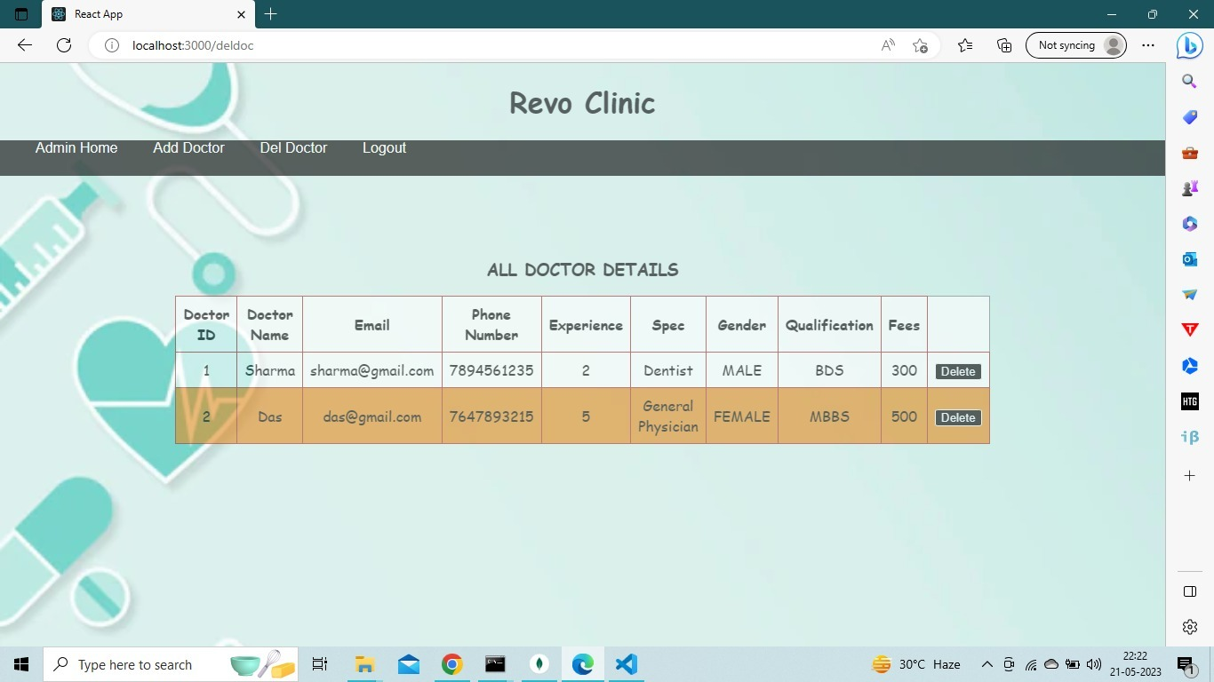
DOCTOR DETAIL’S VIEW/ DELETE BY ADMIN

Slide 13
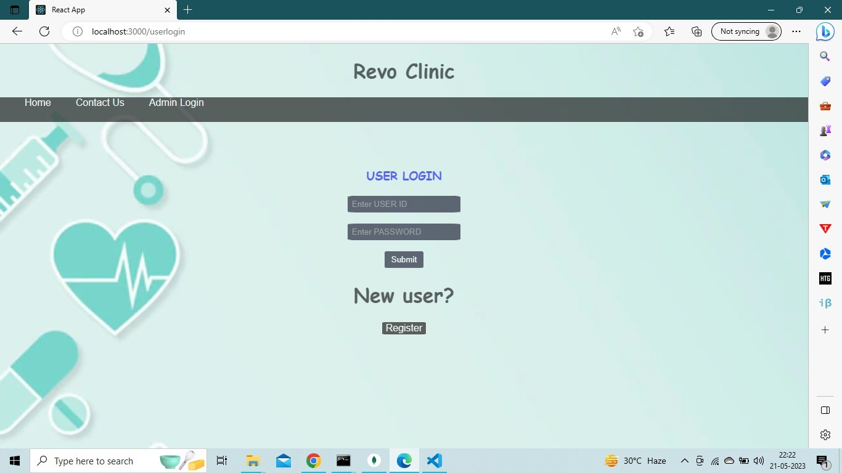
USER LOGIN PAGE FOR EXISTING/ NEW USER(PATIENT)

Slide 14

DOCTOR DETAILS PAGE AFTER USER(PATIENT) LOGIN

Slide 15
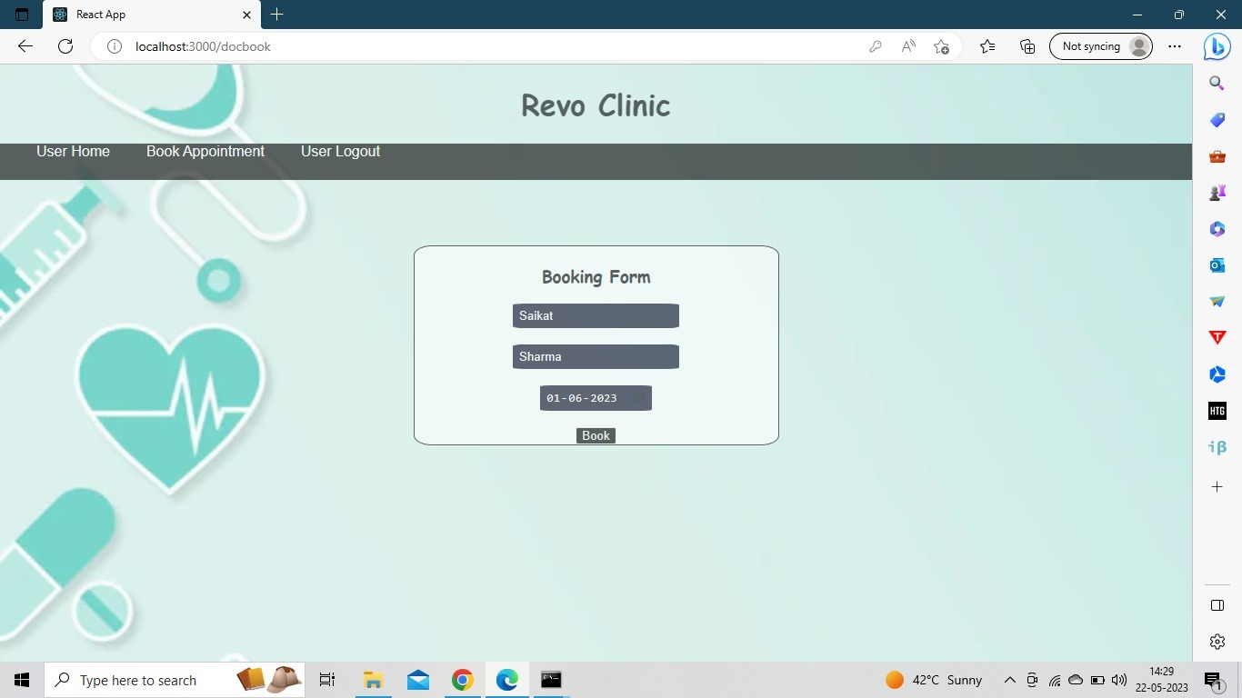
BOOK APPOINTMENT PAGE FOR USER (PATIENT)

Slide 16
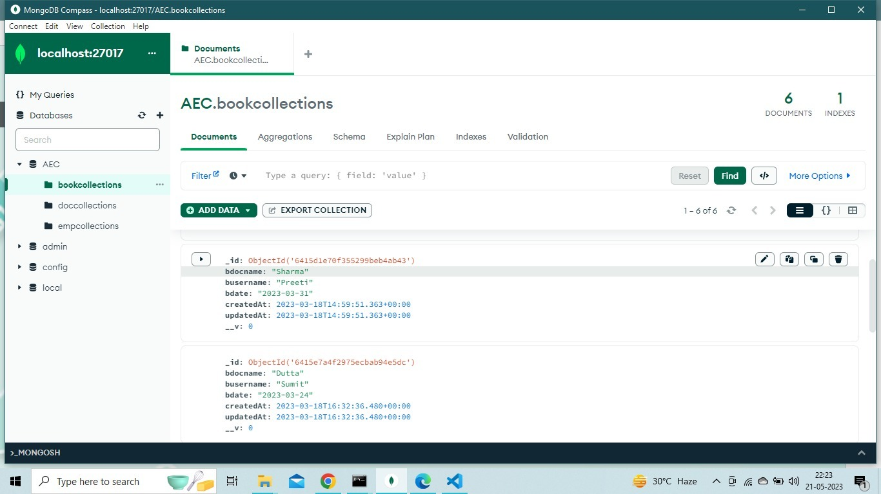
DATABASE SHOWING THE DOCTOR BOOKIMG DETAILS OF USERS (PATIENTS)

Slide 17
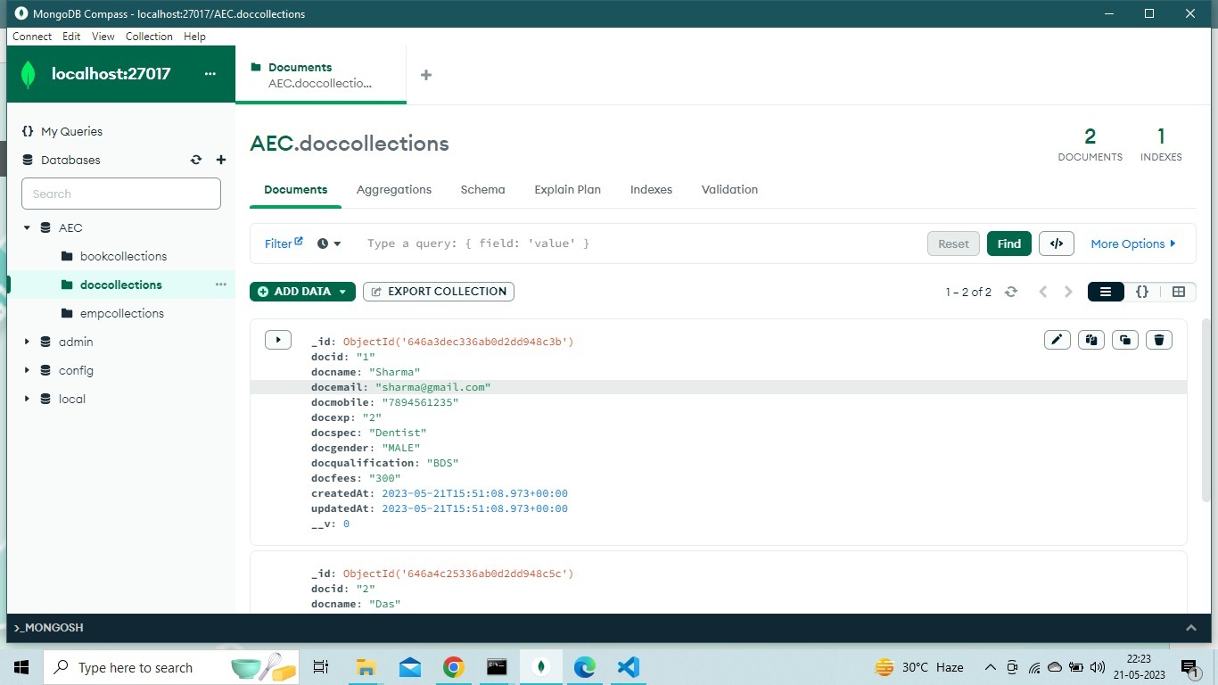
DATABASE SHOWING THE DOCTOR DETAILS FOR ADMIN

Slide 18
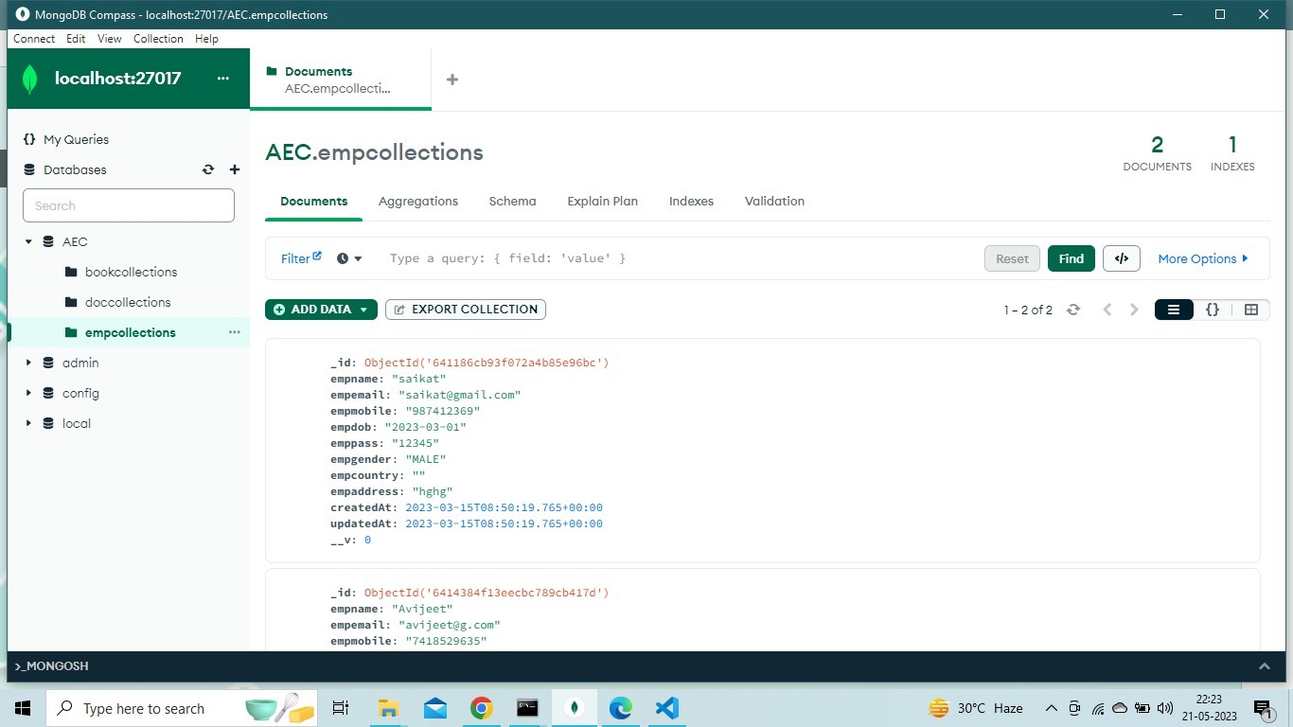
DATABASE SHOWING THE REGISTRATION DETAILS OF USERS (PATIENTS)

Slide 19
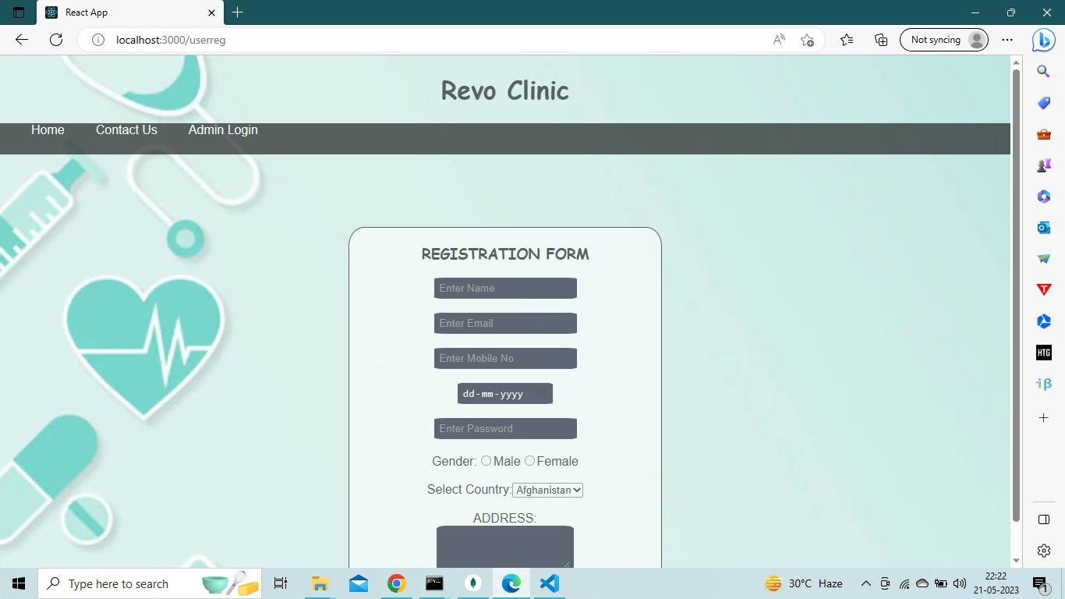
USER(PATIENT) REGISTRATION FORM PAGE FOR NEW USER (PATIENT)

Slide 20
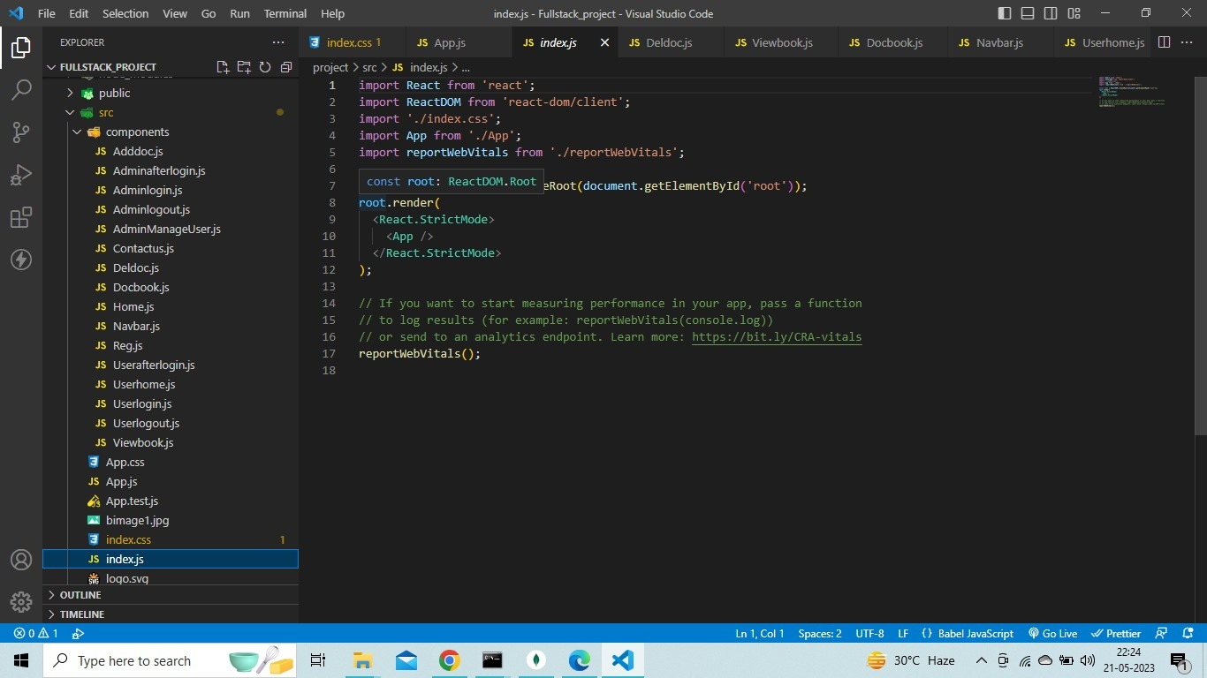
Screenshot showing the component index.js

Slide 21
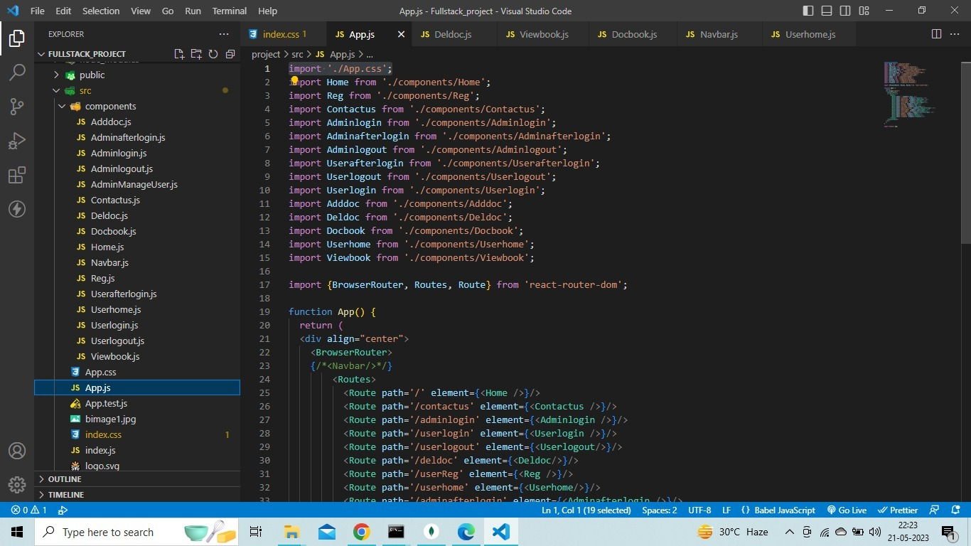
Screenshot showing the main component App.js

Slide 22
FUTURE SCOPE
The MERN Stack project has great potential for future expansion and development. Here are some possible future scope ideas:
• Adding new features: The project can be expanded by adding new features, such as an online forum where students can discuss their queries, a chatbot that can answer common questions, or a virtual classroom with live video streaming and whiteboard capabilities.
• Mobile app development: To reach a wider audience, the project can be converted into a mobile app that can be downloaded from app stores.
• Integration with social media: The project can be integrated with popular social media platforms, such as Facebook, Twitter, and Instagram, to reach a wider audience and allow users to share their progress and achievements.
• Gamification: To make the learning experience more engaging and fun, the project can be gamified with features such as badges, leaderboards, and rewards.
• Personalized learning: The project can be enhanced with machine learning algorithms that can personalize the learning experience for each user based on their learning preferences, pace, and style.
In conclusion, the MERN Stack project has a promising future with endless possibilities for expansion and development. With the addition of new features, mobile app development, social media integration, gamification, and personalized learning, the project can become a valuable resource for students and teachers alike. The project team is grateful for the opportunity to work on this project and looks forward to further developments in the future.

Slide 23

Thank You.
BCA 2020-2023 Batch.
208 555 0164
office@aecwb.edu.in
aecwb.edu.in

